Slide 1
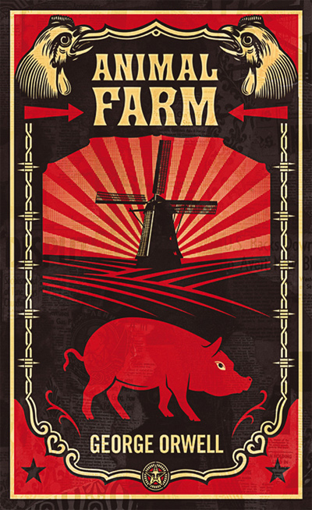
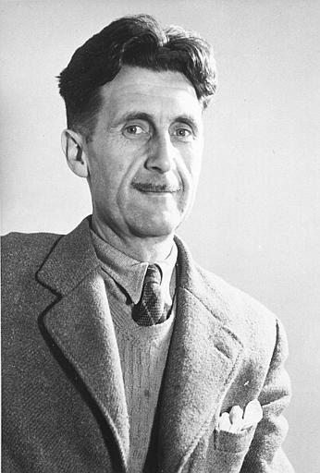
Animal Farm
By George Orwell

Slide 2
The Russian Revolution
Karl Marx was born in Russia in 1818. He was a journalist who was eventually forced to leave his country for his political views.
He wrote The Communist Manifesto, a pamphlet outlining his idea that pure communism would be the inevitable outcome of human history.
Marx stated, “From each according to his abilities, to each according to his need.”

Slide 3
In Russia, by the early 1900’s, Marx’s writings, economic hardship, and the injustices of the Czars led to the Russian Revolution.
On March 15, 1917, Czar Nicholas II was overthrown and later executed, along with his wife and children.
A provisional government of revolutionaries assumed leadership.

Slide 4
Seven months later, the Bolsheviks, led by Vladimir Lenin, overthrew the revolutionaries (October Revolution).
The Bolsheviks renamed themselves the Russian Communist Party and became known as the Reds.
Lenin began the process of rebuilding Russia’s economy, and made progress in industry.
Agriculture remained a problem, because the government favored collective farms, where the peasants could work together and share equipment and crops, but most farmers preferred to farm in the traditional ways.

Slide 5
When Lenin died in 1924, a power struggle began for control of the Communist Party. The two major contenders for control were Leon Trotsky and Joseph Stalin.
Trotsky was a Marxist, and talented party leader who had played an important part in the revolution.
Stalin was the secretary general of the Communist Party and favored a modified form of Marxism.

Slide 6
Trotsky was exiled in 1928, and Stalin became dictator of the Soviet Union. Later, his agents assassinated Trotsky in Mexico.
By 1938, it was clear that Stalin had established a totalitarian dictatorship.
He instituted a number of Five-Year Plans. However, under his leadership, consumer goods began to decrease when he ordered the collective farms to turn over their crops to the government.

Slide 7
The farms’ produce was to be exported by the government to raise money for Soviet Union industrialization.
Nearly eight million peasants who opposed Stalin and were thought to be disloyal were arrested, tried, and sent to labor camps, deported, or executed.
Totalitarianism is a form of government with a strong central rule that attempts to control individuals by means of coercion and repression. —No individual freedoms are allowed under such a system.

Slide 8
The first totalitarian states in modern history were Nazi Germany under Hitler, the Soviet Union under Stalin, Italy under Mussolini, and Spain under General Franco.
The 1939 pact between the Soviet Union and Germany damaged Stalin’s reputation in Britain.
However, by 1944, Russia was again an ally of Britain and was keeping a large number of German forces occupied on the Eastern Front.

Slide 9
Literary history reflected these political realities: four publishers rejected Animal Farm, reluctant to publish a book attacking a British military ally.
Animal Farm was published the year after the war ended (1946), and it brought unfavorable attention to Orwell in Russia.
Orwell continued his efforts to get his work published, and he licensed translations and radio broadcasts of Animal Farm in Eastern Europe.

Slide 10
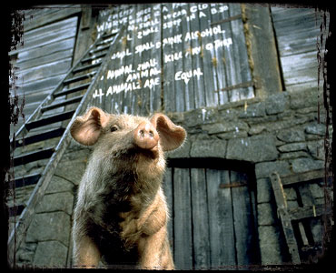
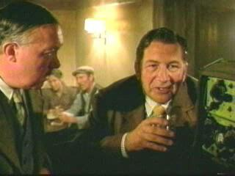
In 1948, the U.S. Information Agency sponsored translations and distribution of Orwell’s book in over thirty languages.
Scenes from Animal Farm

Slide 11
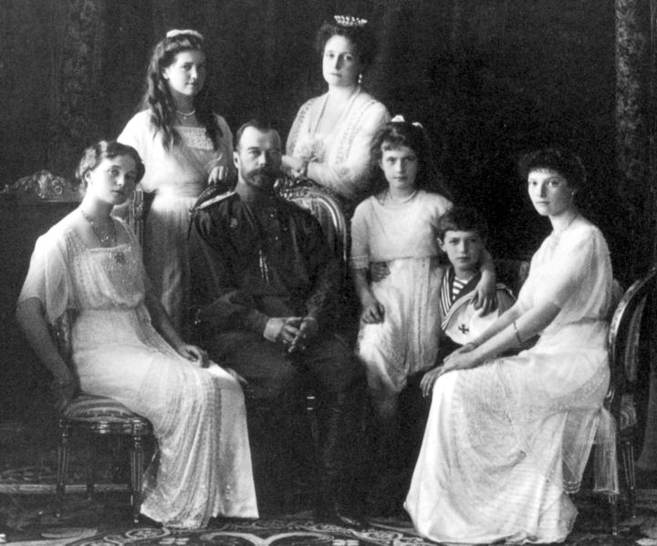
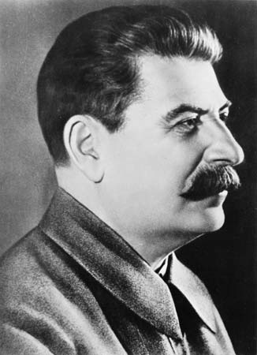
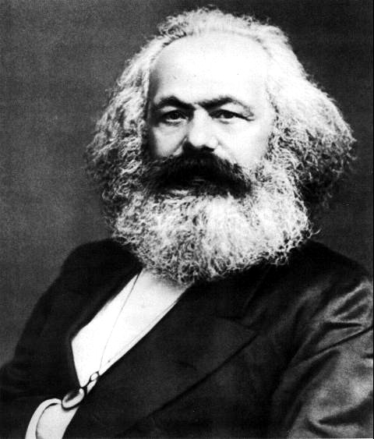
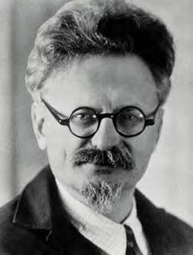
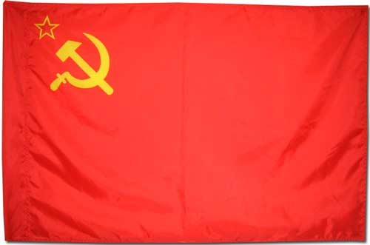
Joseph Stalin
Important Figures and Symbols of the Russian Revolution
The Royal Family: Olga, Maria, Nicholas, Alexandra, Anastasia, Alexei, Tatiana
The USSR Flag
Leon Trotsky
Karl Marx

Slide 12
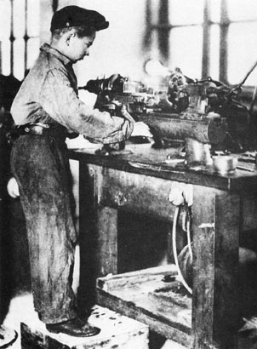
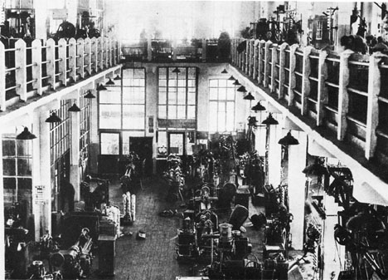
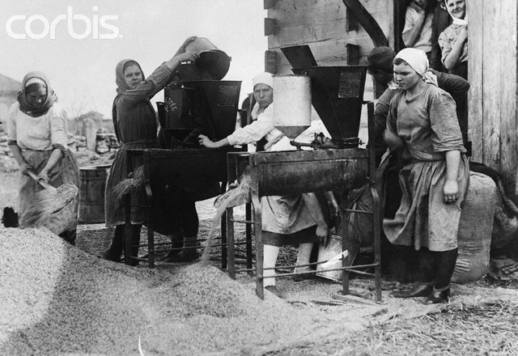
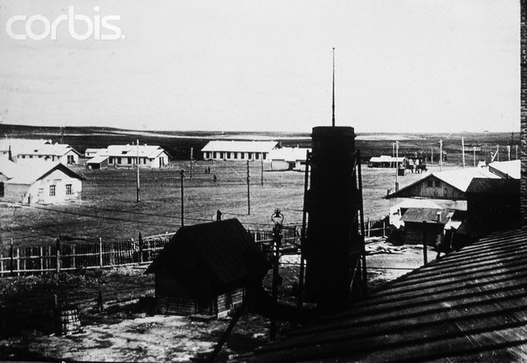
A Russian factory
A young Russian boy working in a drill factory
Images of the working-class people of Communist Russia
A collective farm in Russia
Russian women working to clean grain

