Slide 1
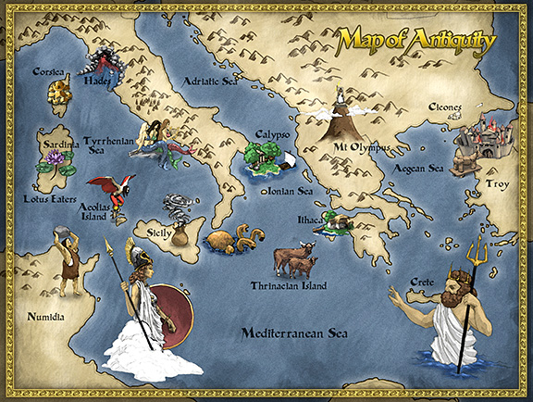
Homer and The Odyssey

Slide 2
The Odyssey was written in the 9th century B.C., and a blind poet named Homer is said to be the author of this epic.
The people of Greece were telling stories about a great war, and Homer compiled these stories into one work.
Homer’s first work was The Iliad, which tells of a ten-year war fought on the plains outside the walls of Troy.

Slide 3
No one is sure who Homer was.
Some scholars believe that Homer was actually two different writers.
Some believe that he was part of a traveling band of minstrels, or “rhapsodes.”
Rhapsodes were “singers of tales” who were the entertainers and historians of the time; they told epics orally.

Slide 4
This epic details the Trojan War and the battle between the people of Troy and the Greeks. This war was fought over a Greek king’s wife, Helen, when she ran off with a Trojan.
The Odyssey takes place after the Trojan War, as Odysseus, a Greek soldier, is trying to return home from the battle.

Slide 5
An Epic Defined
An epic is defined as a long narrative poem presenting adventures on a grand, heroic scale, united through a central figure of heroic proportions.
Epics tell of the adventures of heroes who in some way embody the values of their civilization.

Slide 6
The characteristics of epics include the following:
Action begins in medias res
A muse is invoked
There is a statement of the epic purpose
There are descriptions of warfare
There are supernatural elements
There is a physically impressive hero who is glorified
The setting is vast
There is a quest or journey of some sort.

Slide 7
Odysseus: A Hero in Trouble
In Homer’s time, heroes were considered to be aristocrats, placed between gods and humans.
Heroes were brave, successful, and always “on top of the world.”
Odysseus, however, experiences doubts and troubles.
He had first tried to avoid going to war by pretending to be insane

Slide 8
Odysseus had been respected during the war—the Trojan Horse was his idea, but he still had to create a place for himself in the world.
He was more like a pirate, however, on his way home, raiding towns and villages whenever he and his men landed.
The monsters and other people he met on his journey home did not respect Odysseus, and even the people in his home town seemed to lose respect for him while he was gone.

Slide 9
As Odysseus tried to find respect, his place in the world, and his way home, his son was searching for his father.
While Odysseus was gone, men had been trying to marry his wife and steal his son’s inheritance, so Telemachus decides to search for his father.
The action of the epic begins with Telemachus’ departure to search for Odysseus.

Slide 10
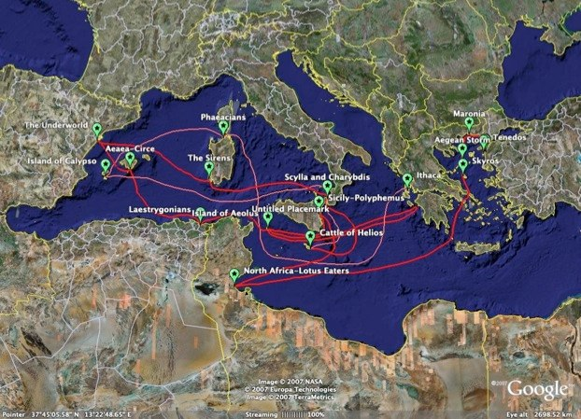
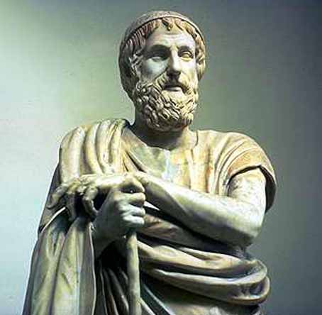
Odysseus’ travels on his journey home.
The poet Homer

Slide 11
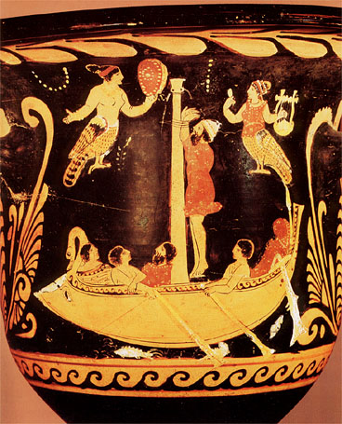
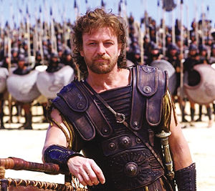
Odysseus through the ages….
South Italian Vase Painting: Odysseus and the Sirens
Odysseus—as portrayed in the movie Troy

Slide 12
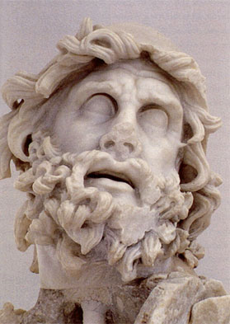
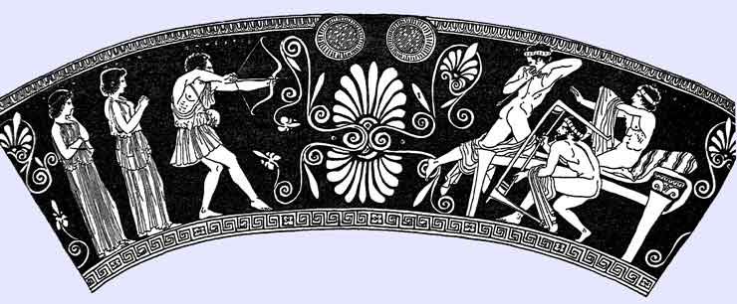
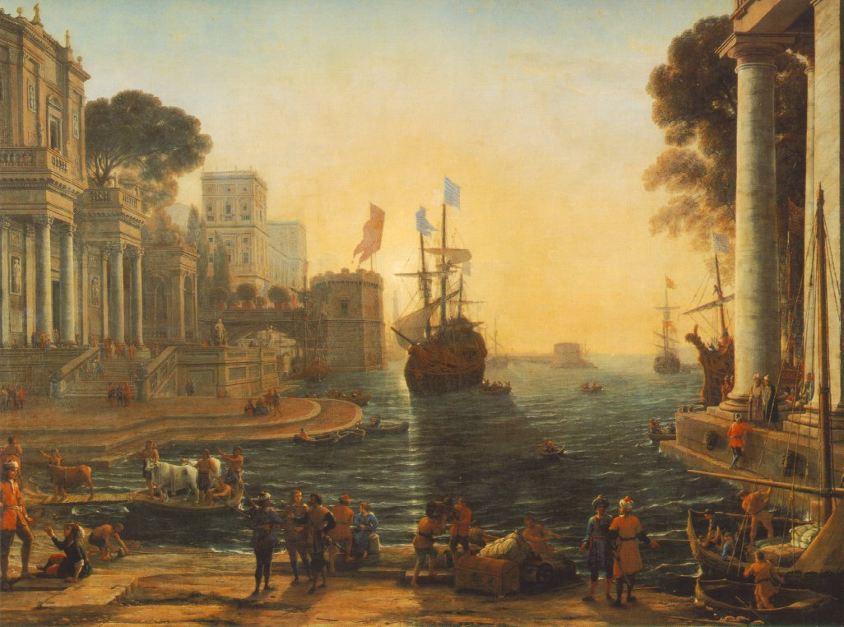
Odysseus killing the suitors of his wife Penelope, c. 440 BC, from Tarquinia, by the Penelope Painter
The Return of Odysseus, Claude Lorrain, 1644.
Head of Odysseus from a scuptural group representing Odysseus killing Polyphemus. Marble, Greek artwork of the 2nd century BC. From the villa of Tiberius at Sperlonga.

